Slide 1
Digital Signal Processing(BEC-303)
Unit-1
Lecture-8
Presented By:
Dr. Ishwar Chandra Yadav

Slide 2
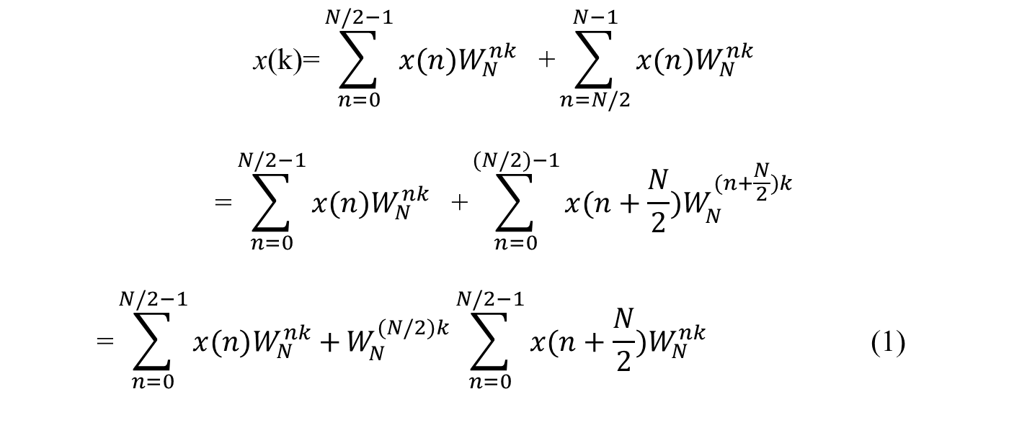
Decimation in frequency algorithms
To derive into the decimation-in-frequency FFT algorithm for N , a power of 2, the input sequence x(n) is divided into the first half and the last half of the points as discussed below.
$$\text{x}\text{(}\text{k}\text{)=}\sum_{n=0}^{N/2−1}{x(n)W_{N}^{nk}}\text{ +}\sum_{n=N/2}^{N−1}{x(n)W_{N}^{nk}}$$
$$\text{=}\sum_{n=0}^{N/2−1}{x(n)W_{N}^{nk}}\text{ +}\sum_{n=0}^{(N/2)−1}{x(n+\frac{N}{2})W_{N}^{(n+\frac{N}{2})k}}$$
$$\text{=}\sum_{n=0}^{N/2−1}{x(n)W_{N}^{nk}+}W_{N}^{(N/2)k}\sum_{n=0}^{N/2−1}{x(n+\frac{N}{2})W_{N}^{nk}}\text{ (1) }$$

Slide 3
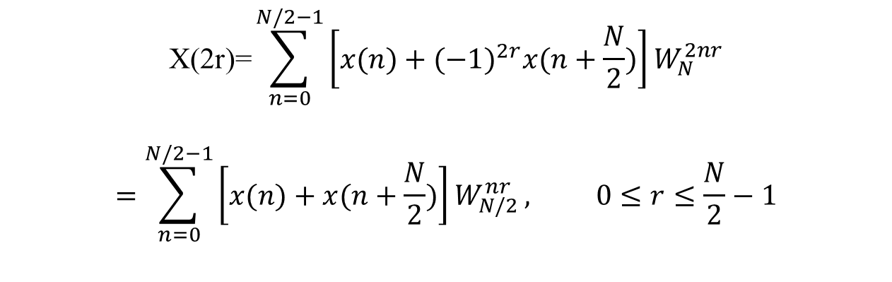
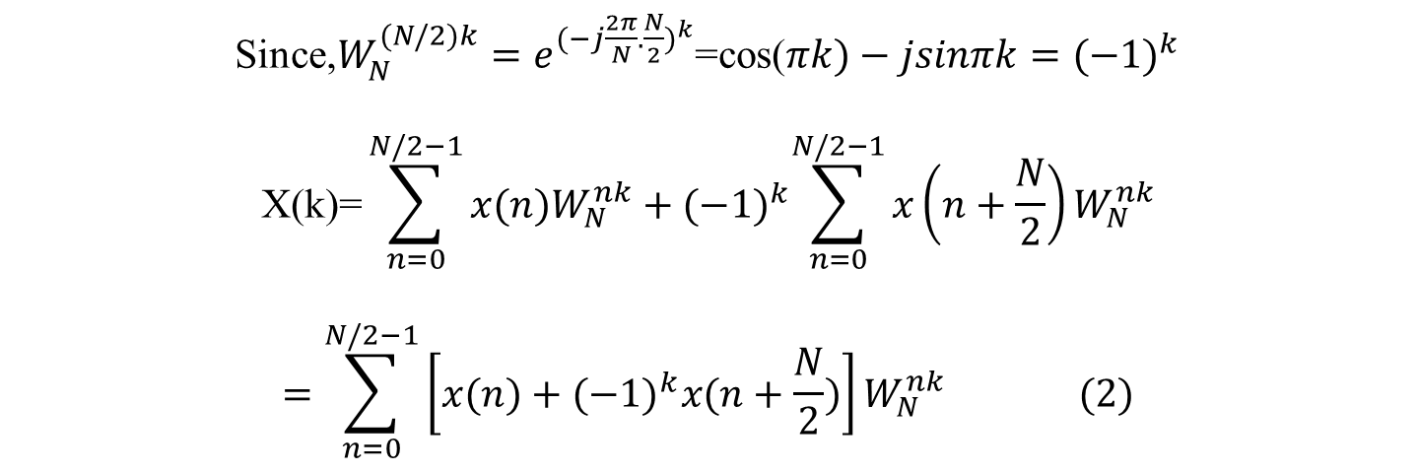
Since,$W_{N}^{(N/2)k}=e^{{(−j\frac{2π}{N}.\frac{N}{2})}^{k}}$=cos($πk)−jsinπk={(−1)}^{k}$
$$\text{X}\text{(}\text{k}\text{)=}\sum_{n=0}^{N/2−1}{{x(n)W}_{N}^{nk}}+{(−1)}^{k}\sum_{n=0}^{N/2−1}{x\left(n+\frac{N}{2}\right)W_{N}^{nk}}$$
$$=\sum_{n=0}^{N/2−1}{{\left[x(n)+{(−1)}^{k}x(n+\frac{N}{2})\right]W}_{N}^{nk}} (2)$$
Decomposing the sequence in the frequency domain , X(k), into an even numbered subsequence X(2r) and an odd numbered subsequence X(2r + 1) where r=0,1,2,……..(N/2 -1),yields
$$\text{X}\text{(2}\text{r}\text{)=}\sum_{n=0}^{N/2−1}{{\left[x(n)+{(−1)}^{2r}x(n+\frac{N}{2})\right]W}_{N}^{2nr}}$$
$$=\sum_{n=0}^{N/2−1}{{\left[x(n)+x(n+\frac{N}{2})\right]W}_{N/2}^{nr}}, 0≤r≤\frac{N}{2}−1$$

Slide 4

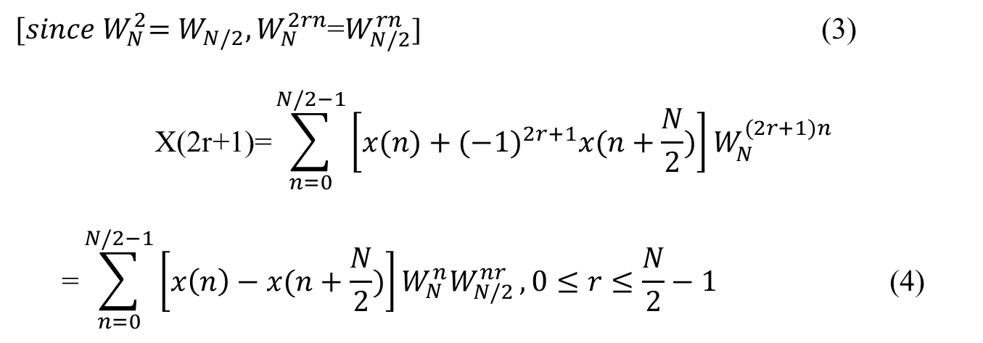
${[since W}_{N}^{2}=W_{N/2},W_{N}^{2rn}$=$W_{N/2}^{rn}$] (3)
$$\text{X}\text{(2}\text{r}\text{+1)=}\sum_{n=0}^{N/2−1}{{\left[x(n)+{(−1)}^{2r+1}x(n+\frac{N}{2})\right]W}_{N}^{(2r+1)n}}$$
$$\text{=}\sum_{n=0}^{N/2−1}{{\left[x\left(n\right)−x(n+\frac{N}{2})\right]W_{N}^{n}W}_{N/2}^{nr}}, 0≤r≤\frac{N}{2}−1 \text{(4)}$$
From Eq. (3), $g\left(n\right)=x\left(n\right)+x(n+\frac{N}{2})$
From Eq. (4), $h\left(n\right)=x\left(n\right)−x(n+\frac{N}{2})$

Slide 5
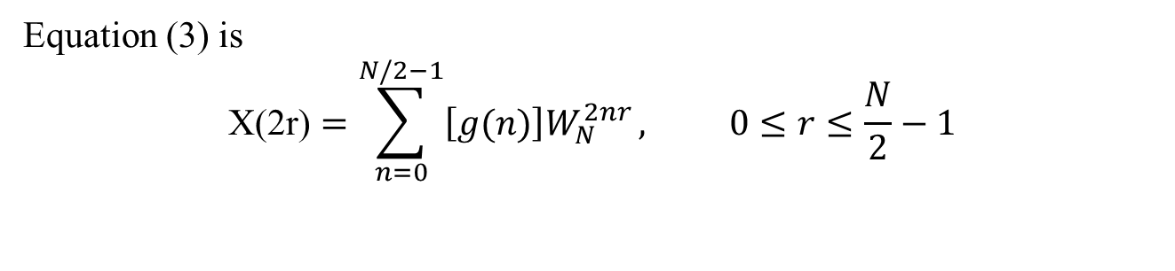
For an 8-point DFT N=8,
g(0)=x(0)+x(4) h(0)=x(0)-x(4)
g(1)=x(1)+x(5) h(1)=x(1)-x(5)
g(2)=x(2)+x(6) h(2)=x(2)-x(6)
g(3)=x(3)+x(7) h(3)=x(3)-x(7)
The flow –graph of the first stage of an 8 point DFT computation scheme defined by Eqs(3)and (4) is shown in Fig.1
Equation (3) is
$$\text{X}\text{(2}\text{r}\text{)}=\sum_{n=0}^{N/2−1}{{\left[g(n)\right]W}_{N}^{2nr}}, 0≤r≤\frac{N}{2}−1$$

Slide 6
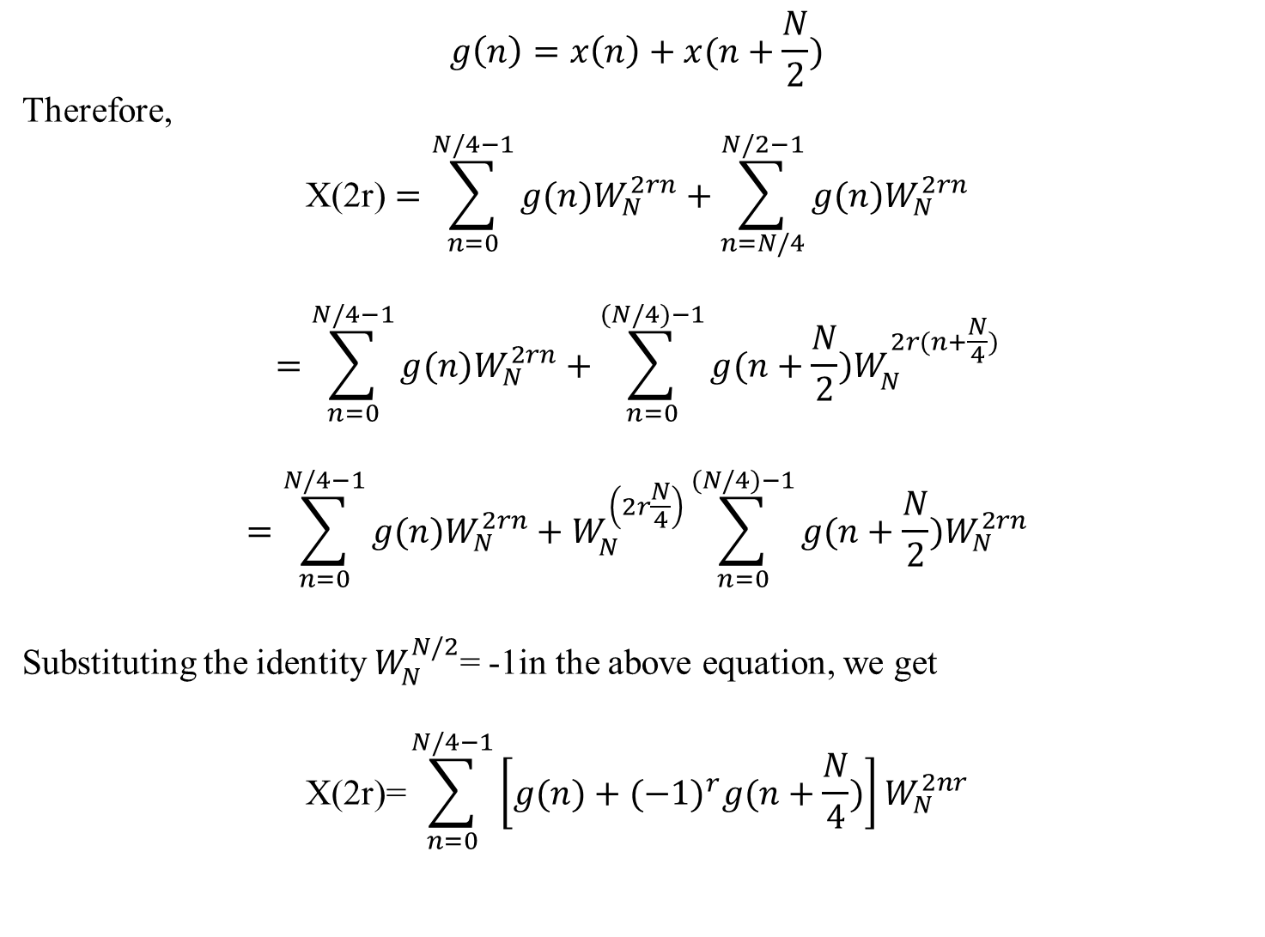
$$g\left(n\right)=x\left(n\right)+x(n+\frac{N}{2})$$
Therefore,
$$\text{X}\text{(2}\text{r}\text{)}=\sum_{n=0}^{N/4−1}{{g(n)W}_{N}^{2rn}+\sum_{n=N/4}^{N/2−1}{{g(n)W}_{N}^{2rn}}}$$
$$=\sum_{n=0}^{N/4−1}{{g(n)W}_{N}^{2rn}+\sum_{n=0}^{(N/4)−1}{{g(n+\frac{N}{2})W}_{N}^{2r(n+\frac{N}{4})}}}$$
$$=\sum_{n=0}^{N/4−1}{{g(n)W}_{N}^{2rn}+W_{N}^{\left(2r\frac{N}{4}\right)}\sum_{n=0}^{(N/4)−1}{{g(n+\frac{N}{2})W}_{N}^{2rn}}}$$
Substituting the identity $W_{N}^{N/2}$= -1in the above equation, we get
$$\text{X}\text{(2}\text{r}\text{)=}\sum_{n=0}^{N/4−1}{{\left[g(n)+{(−1)}^{r}g(n+\frac{N}{4})\right]W}_{N}^{2nr}}$$

Slide 7
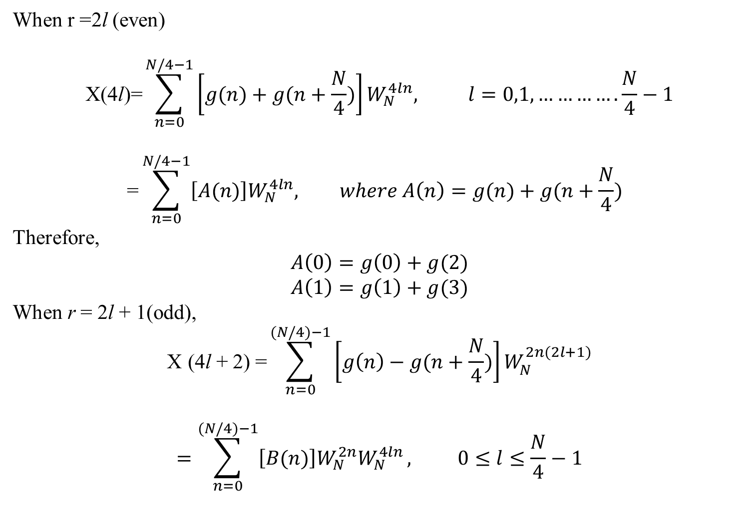
When r =2l (even)
$$\text{X}\text{(4}\text{l}\text{)=}\sum_{n=0}^{N/4−1}{{\left[g(n)+g(n+\frac{N}{4})\right]W}_{N}^{4ln}, l=0,1,………….}\frac{N}{4}−1$$
$$\text{=}\sum_{n=0}^{N/4−1}{{\left[A(n)\right]W}_{N}^{4ln}, where A\left(n\right)=g(n)+g(n+\frac{N}{4}) }$$
$$\text{Therefore}\text{,}$$
$$A\left(0\right)=g\left(0\right)+g(2)$$
$$A\left(1\right)=g\left(1\right)+g(3)$$
When r = 2l + 1(odd),
$$\text{X} \text{(4}\text{l} \text{+} \text{2)} \text{=}\sum_{n=0}^{(N/4)−1}{{\left[g\left(n\right)−g(n+\frac{N}{4})\right]W}_{N}^{2n(2l+1)}}$$
$$=\sum_{n=0}^{(N/4)−1}{{\left[B(n)\right]W}_{N}^{2n}W_{N}^{4ln}}, 0≤l≤\frac{N}{4}−1$$

Slide 8
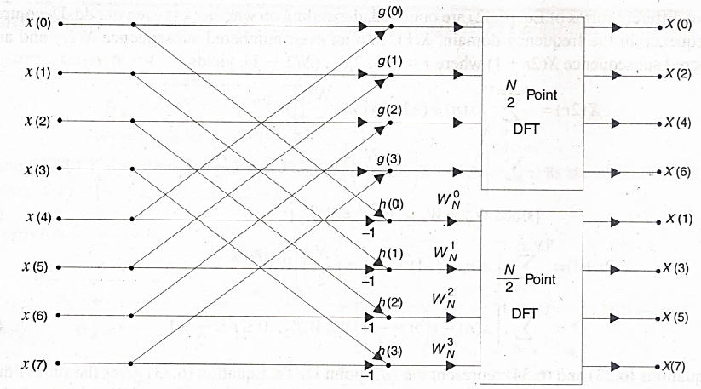
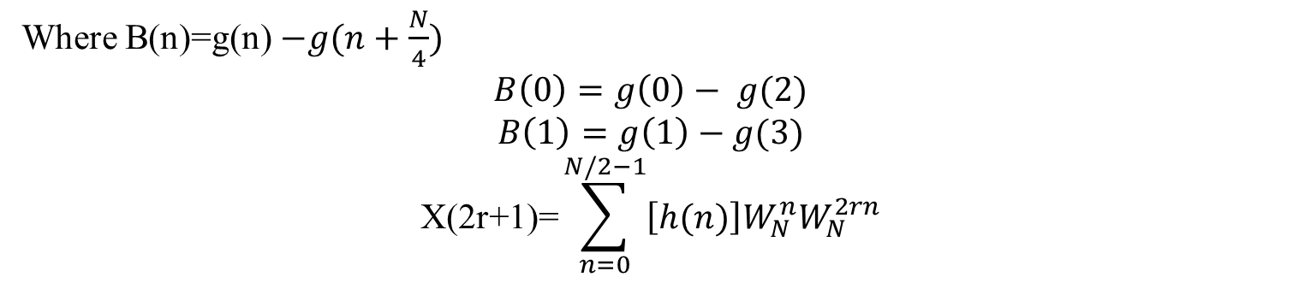
Figuar:1 Flow Graph of the First Stage of Decimation-in-Frequency FFT for N=8
Where B(n)=g(n)$−g(n+\frac{N}{4})$
$$B\left(0\right)=g\left(0\right)− g(2)$$
$$B\left(1\right)=g\left(1\right)−g(3)$$
$$\text{X}\text{(2}\text{r}\text{+1)=}\sum_{n=0}^{N/2−1}{{\left[h(n)\right]W}_{N}^{n}W_{N}^{2rn}}$$

Slide 9
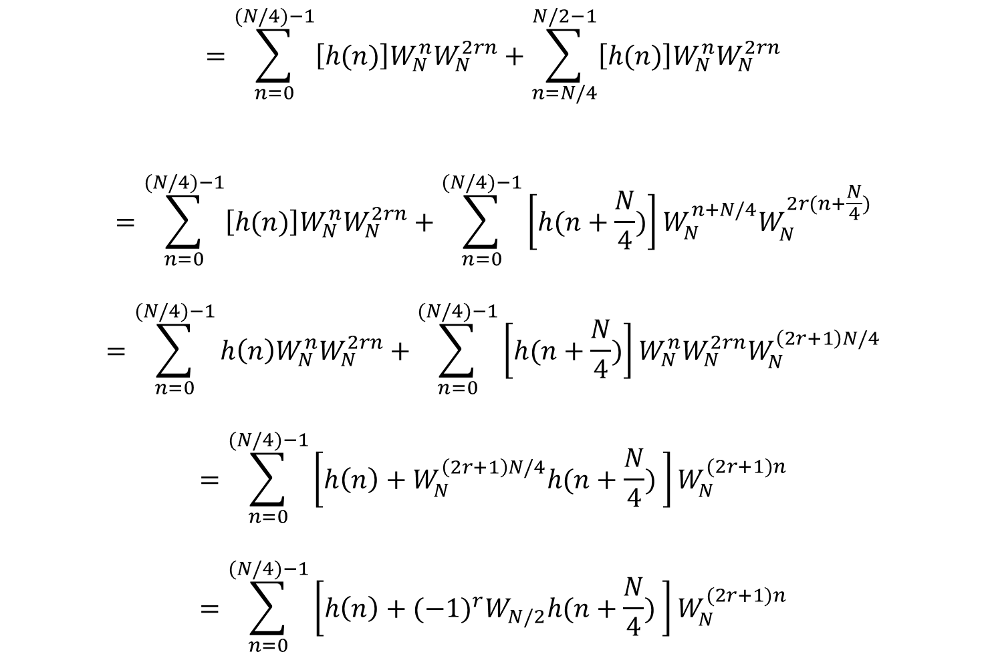
$$=\sum_{n=0}^{(N/4)−1}{{\left[h(n)\right]W}_{N}^{n}W_{N}^{2rn}+\sum_{n=N/4}^{N/2−1}{{\left[h(n)\right]W}_{N}^{n}W_{N}^{2rn}}}$$
$$=\sum_{n=0}^{(N/4)−1}{{\left[h(n)\right]W}_{N}^{n}W_{N}^{2rn}+\sum_{n=0}^{(N/4)−1}{{\left[h(n+\frac{N}{4})\right]W}_{N}^{n+N/4}W_{N}^{2r(n+\frac{N}{4})}}}$$
$$=\sum_{n=0}^{(N/4)−1}{{h\left(n\right)W}_{N}^{n}W_{N}^{2rn}+\sum_{n=0}^{(N/4)−1}{{\left[h(n+\frac{N}{4})\right]W}_{N}^{n}W_{N}^{2rn}W_{N}^{\left(2r+1\right)N/4}}}$$
$$=\sum_{n=0}^{(N/4)−1}{{\left[h\left(n\right)+W_{N}^{\left(2r+1\right)N/4}h(n+\frac{N}{4}) \right]W}_{N}^{(2r+1)n}}$$
$$=\sum_{n=0}^{(N/4)−1}{{\left[h\left(n\right)+{(−1)}^{r}W_{N/2}h(n+\frac{N}{4}) \right]W}_{N}^{(2r+1)n}}$$

Slide 10
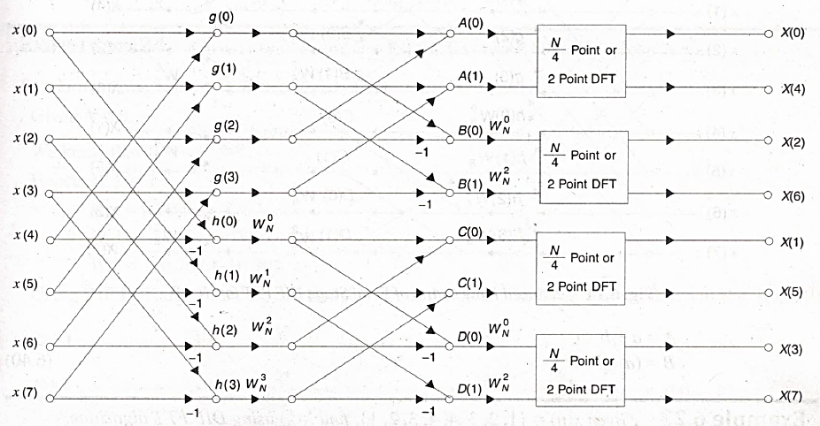
Figure 6.9 shows the flow-graph of the second stage of decimation in frequency decomposition of an 8-point DFT into four 2-point DFT computations.
Figure :2 Flow Graph of the second Stage of decimation in-frequency FFT foe N=8

Slide 11
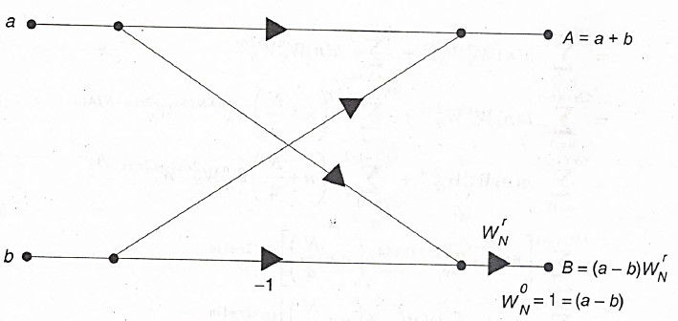
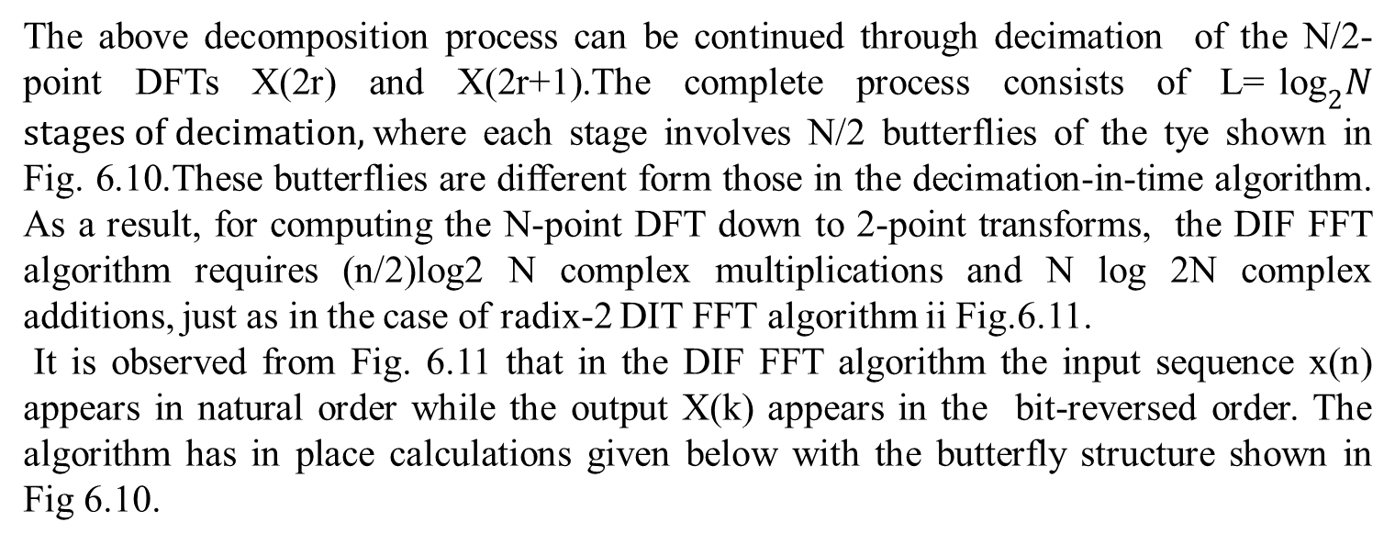
The above decomposition process can be continued through decimation of the N/2-point DFTs X(2r) and X(2r+1).The complete process consists of L=${\text{log}}_{2}N$ $stages of decimation,$where each stage involves N/2 butterflies of the tye shown in Fig. 6.10.These butterflies are different form those in the decimation-in-time algorithm. As a result, for computing the N-point DFT down to 2-point transforms, the DIF FFT algorithm requires (n/2)log2 N complex multiplications and N log 2N complex additions, just as in the case of radix-2 DIT FFT algorithm ii Fig.6.11.
It is observed from Fig. 6.11 that in the DIF FFT algorithm the input sequence x(n) appears in natural order while the output X(k) appears in the bit-reversed order. The algorithm has in place calculations given below with the butterfly structure shown in Fig 6.10.
Figure : 3 Basic butterfly for DIF FFT

Slide 12
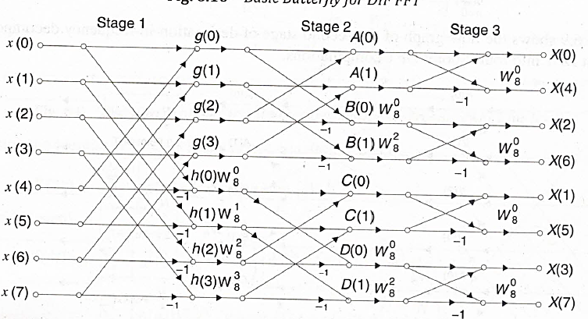
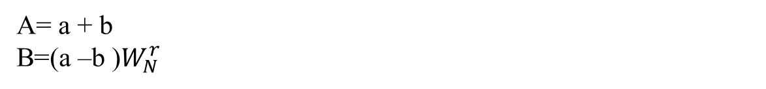
Figure: 4 Reduced Flow Graph of Final Stage DIF FFT for N=8
A= a + b
B=(a –b )$W_{N}^{r}$

